Slide 1








VORTEXA
3.0
12 HRS HACKATHON
POWERED BY A.I.R.S
DOMAIN & NO : 07, G-01
PROBLEM STATEMENT TITLE :
RozgarLink: Skills-to-Opportunity Matching Engine
TEAM NAME : Binary Brains
TEAM ID : rO3EvgBd

Slide 2
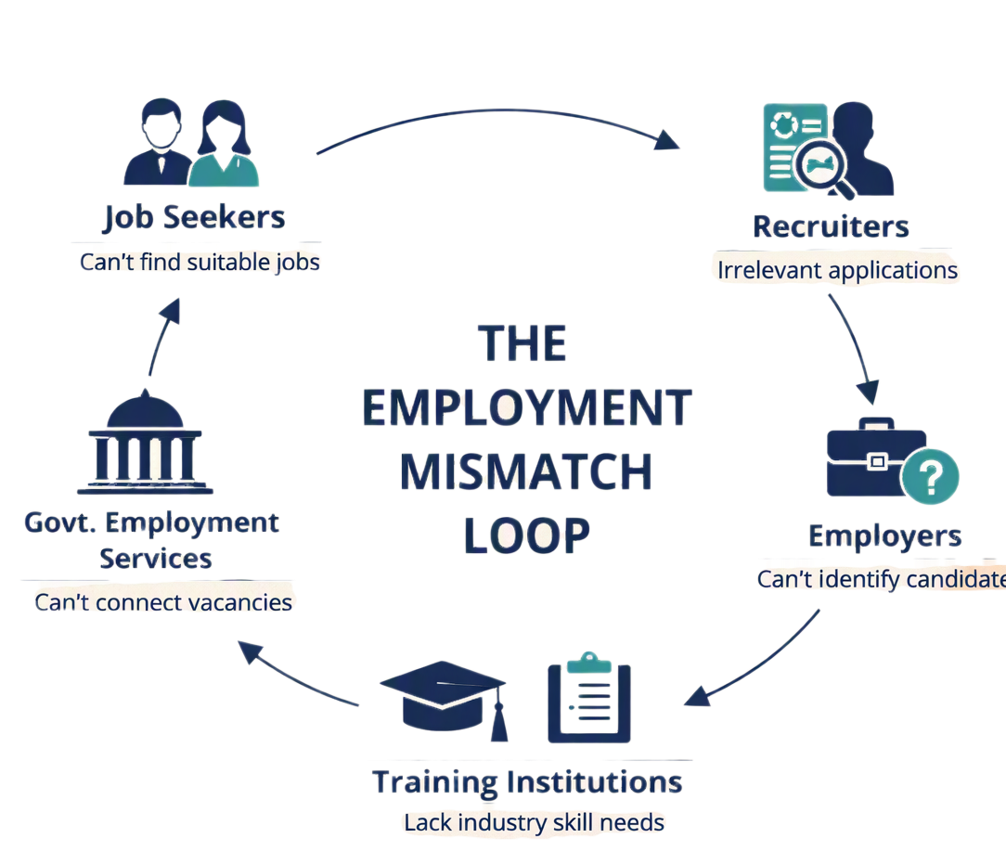

PROBLEM STATEMENT
Job seekers miss suitable opportunities due to skill-wording mismatches and unclear eligibility requirements.
Problems Faced by Different Users :
Job Seekers: Difficulty finding suitable jobs and understanding eligibility or skill gaps.
Recruiters: Too many irrelevant applications and time-consuming screening.
Government Services: Difficulty connecting candidates with suitable vacancies.
Training Institutions: Difficulty aligning courses with industry skill requirements.
Supporting Facts
28.4% — Graduate youth unemployment in India (2023). (ILO, 2024)
Nearly 2 in 5 — Technically qualified youth were overqualified for their jobs (2022). (ILO)
63% of employers — Cited skill gaps as a major barrier. (WEF, 2025)
39% of workers’ skills — Expected to change or become outdated by 2030. (WEF, 2025)

Slide 3

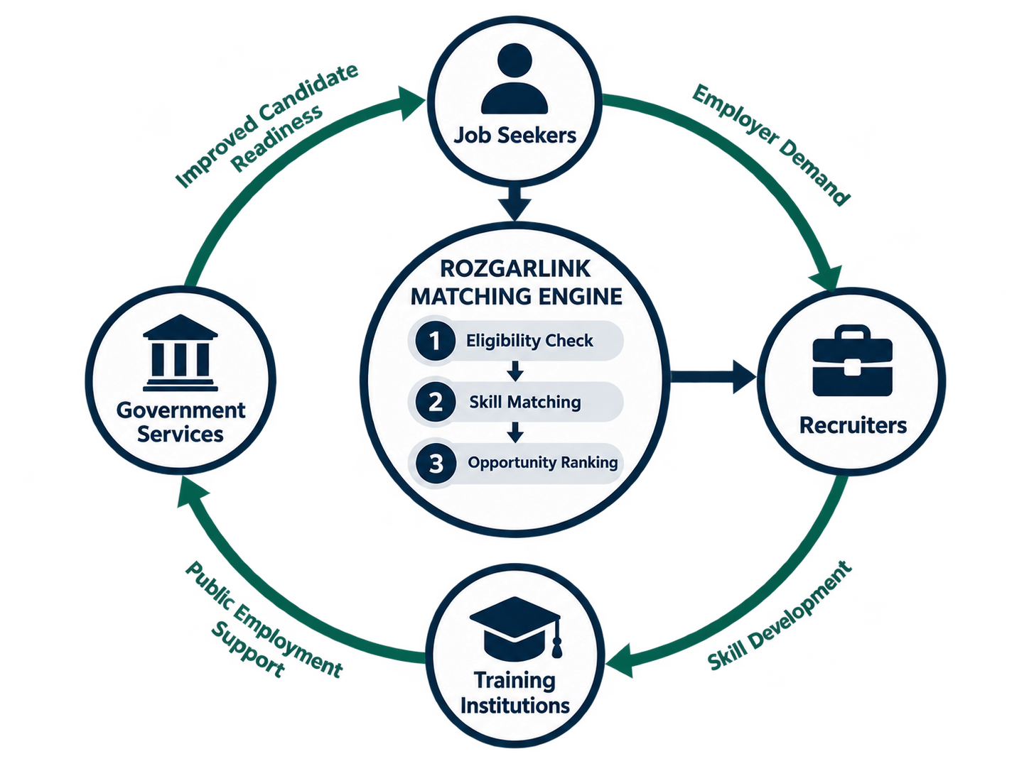
PROPOSED SOLUTION
RozgarLink is a skill-based opportunity matching platform that checks mandatory eligibility first, matches equivalent skills beyond exact keywords, explains why candidates qualify or fail, and recommends skill-gap learning resources to connect people with suitable jobs and training opportunities.
RozgarLink – Core Features:
Smart Skill Matching – Matches similar skills beyond exact keywords.
Eligibility Verification – Checks mandatory requirements first.
Explainable Results – Shows why candidates qualify or fail.
Skill Gap Analysis – Identifies missing skills.
Learning Recommendations – Suggests relevant learning resources.
Dynamic Re-matching – Updates results when profiles change.
Opportunity Ranking – Ranks eligible opportunities by relevance.
Other Features
Verified Skill Profiles
Fairness-Aware Ranking
Alternative Career Paths
Recruiter Feedback Loop
Multi-Pathway Recommendations
Skill Demand Insights

Slide 4
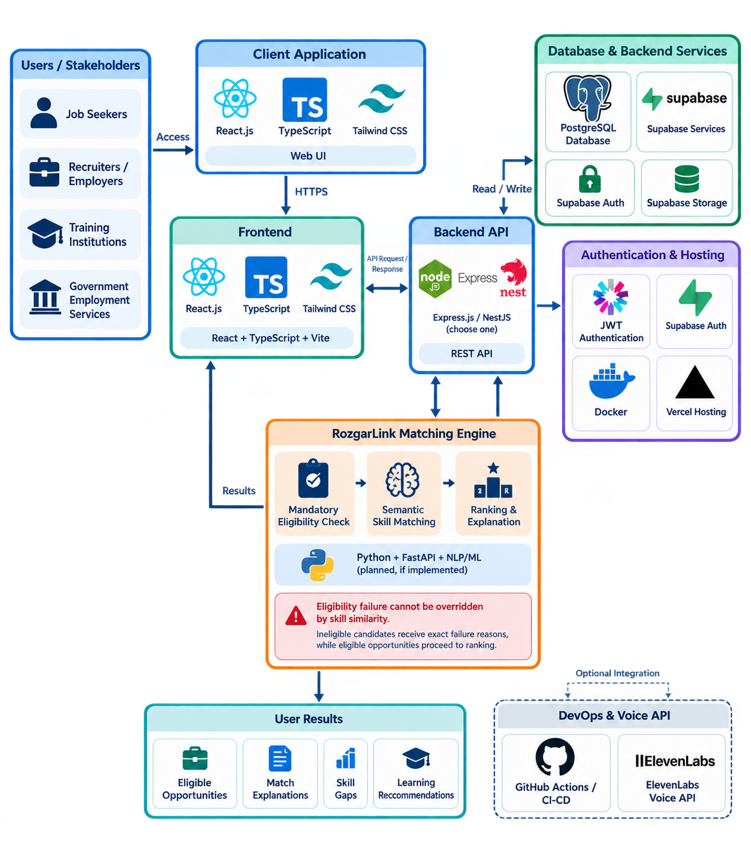
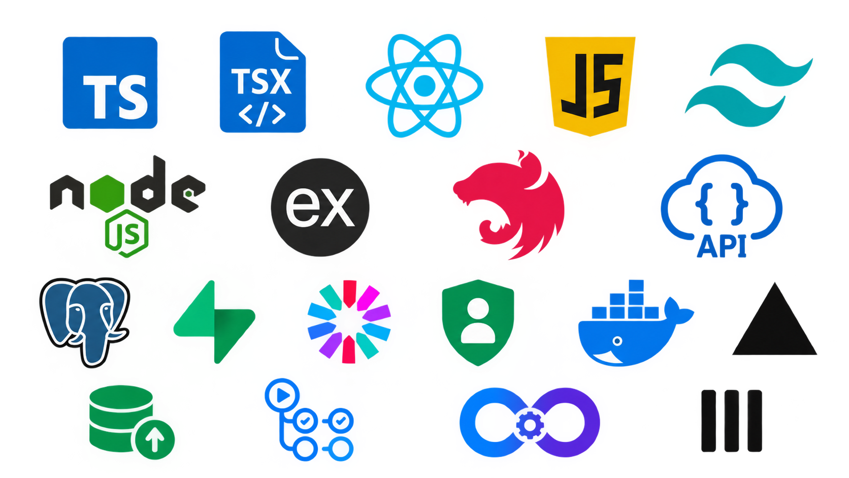
TECHNICAL APPROACH
Tech Stack:
Frontend: TypeScript,React.js, JS, Tailwind CSS
Backend: Node.js, Express.js, NestJS, REST API
Database: PostgreSQL
Backend Services: Supabase
Authentication: JWT, Supabase Auth
Server & Hosting: Docker, Vercel
Storage: Supabase Storage
DevOps: GitHub Actions, CI/CD
Voice API: ElevenLabs
System Architecture:

Slide 5
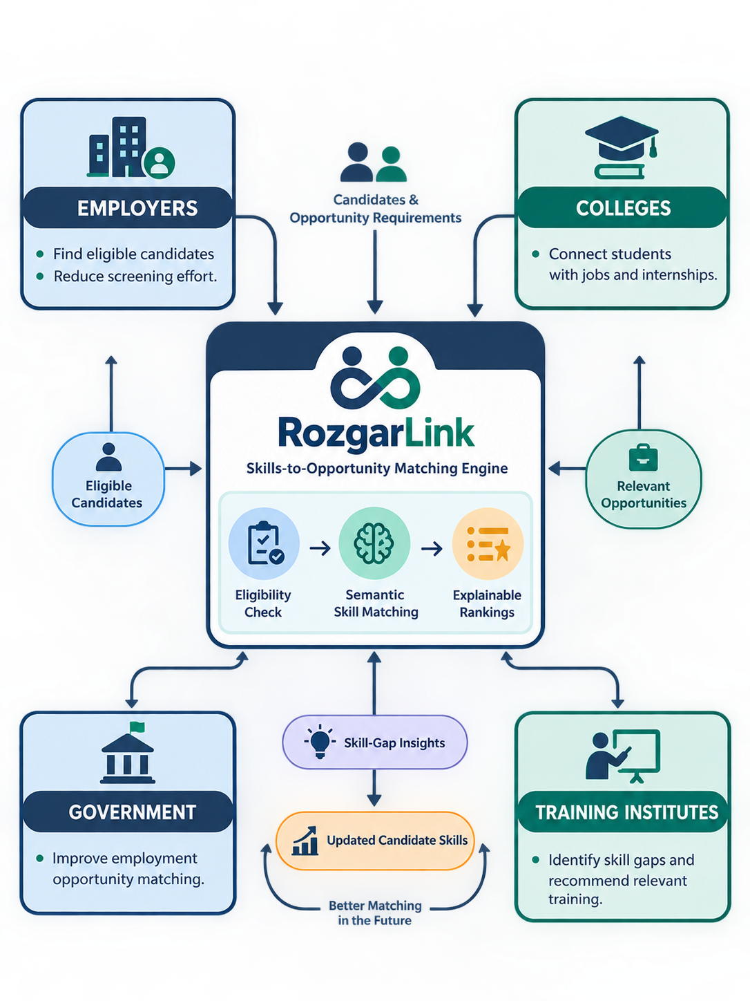




FEASIBILITY AND VIABILITY
Feasibility
Built using React, Node.js, PostgreSQL and Supabase.
Rule-based eligibility checks; NLP-based skill matching.
MVP possible with sample data and curated learning resources.
Viability
Growing Demand: Increasing skill gaps create a need for smarter job matching.
Existing Ecosystem: Can integrate with colleges, employers and employment services.
Scalable Platform: Can expand across industries, locations and skill levels.
Business Opportunities
Recruitment SaaS: Smart hiring tools for employers.
College Placements: Student placement and skill analytics.
Government Contracts: Public employment-matching systems.
Training Partnerships: Connect users with relevant courses.
Premium Dashboards: Candidate rankings and skill-demand insights.
Supporting Facts:
63% of employers identify skill gaps as a major barrier to business transformation. (WEF, 2025)
3.43 crore vacancies were mobilised through India's National Career Service portal in FY 2025–26. (Government of India, 2026)
1.5 crore+ candidates have registered on Skill India Digital Hub. (Government of India, 2026)
39% of workers’ skills are expected to change or become outdated by 2030. (WEF, 2025)

Slide 6
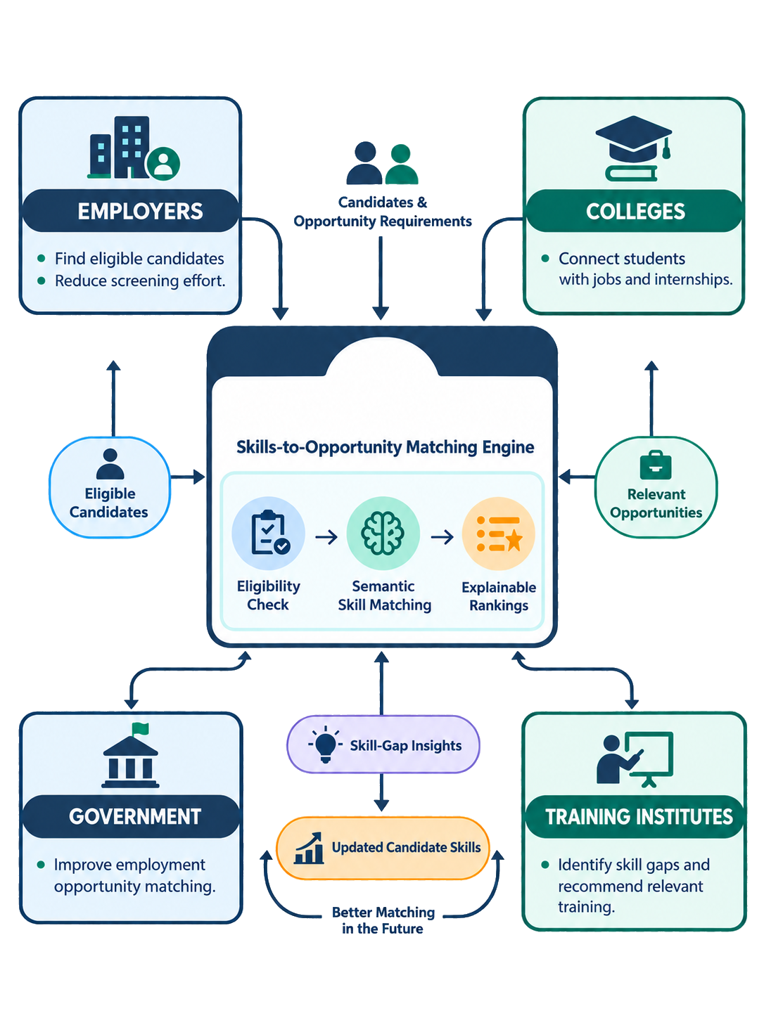
IMPACT AND BENEFITS
Impact on Target Audience
Job Seekers: Better job matching and career readiness.
Employers: Faster hiring and fewer irrelevant applications.
Colleges: Improved placement outcomes and skill-gap insights.
Training Institutes: Training aligned with industry requirements.
Government: Better access to employment opportunities.
Benefits of the Solution
Social
More accessible and transparent job matching.
Clear eligibility and skill-gap explanations.
Economic
Reduced recruitment screening effort.
Better use of hiring resources.
Educational
Targeted skill-development recommendations.
Improved job readiness for students.
Technological
Semantic skill matching beyond keywords.
Explainable, eligibility-first rankings.
Institutional
Insights into common skill gaps.
Better alignment between training and job requirements.

Slide 7
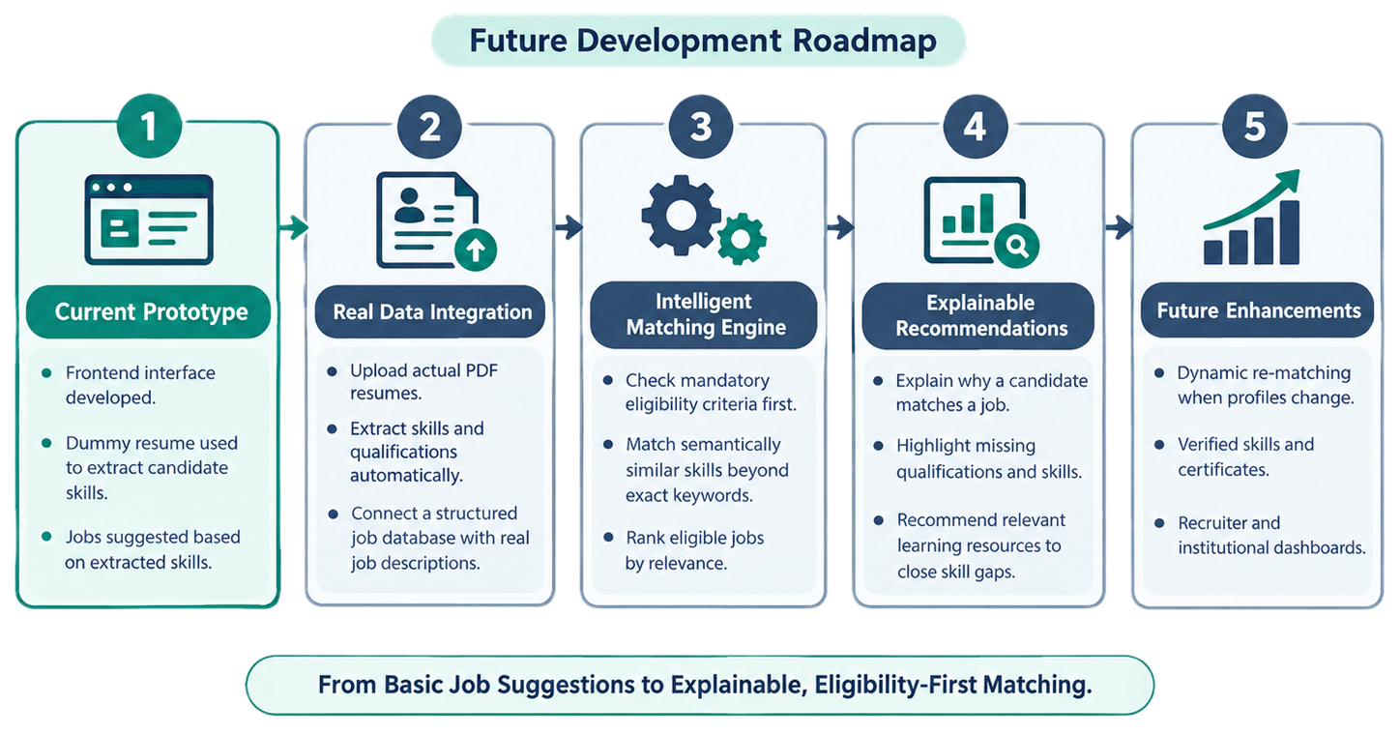

DIFFERENTIATOR
Feature | RozgarLink | Traditional Job Platforms
Jobs & Internships | ✓ | ✓
Eligibility-First Matching | ✓ | Partial
Semantic Skill Matching | ✓ | Partial
Skill-Gap Analysis | ✓ | Partial
Explainable Match Results | ✓ | Partial
Personalized Learning Recommendations | ✓ | Partial
Dynamic Re-Matching | ✓ | Partial
Institution Skill Analytics | ✓ | Partial
Research Resources
https://www.weforum.org/publications/the-future-of-jobs-report-2025/
https://www.ilo.org/publications/india-employment-report-2024-youth-employment-education-and-skills
https://www.skillindiadigital.gov.in/
https://www.ncs.gov.in/
https://www.weforum.org/stories/all/the-future-of-jobs-in-india-employers-seek-to-boost-tech-talent-to-drive-ai-and-digital-technology-growth/
Live Demo: https://rozgarsathi.vercel.app/

Slide 8










THANK YOU!
Game’s
Still On
VORTEXA 3.0
AIRS

